Slide 1
APAN5400
Project Presentation
Jacqueline Lin ,Jingyi Zhu, Sicheng Yu, Yinqi Yang, Zhiyi Guo
Group 9
Notes:
Pipi

Slide 2

Dataset Background
Description：
The dataset "Market News & Sentiment Trending" from Alpha Vantage is a collection of real-time and past reports from news organizations around the world, as well as Sentiment data. The dataset includes data on a range of topics such as stocks, cryptocurrencies, forex, M&A, finance, IPOs, and a whole range of other topics.
Format:
By automating the selection of big data application with URLs, titles, and a series of topics and summarizing the ratings, the scores are then compared to obtain an initial relevance score. With tickers to filter out the desired information and finalize the relevance score, sentiment score, and label.
Notes:
pipi
What is included in the api

Slide 3

Definition of the Business Use or Data Analytics Case
The topics in each list will provide great value and data components for future business as well as data analytics use. Especially with a huge database, we can use big data analytics to get the goals we wish to obtain.
Case in Business & DA uses
Financial landscape: Firms can analyze their own financial situation through past as well as real-time stock prices. And identify problem areas and handle them to ensure financial stability.
Investment strategies: Give the price situation in the market to give whether each stock or product is positive or negative. Analyze the trend to ensure that the investment choice is correct.
Market price timing & Risk management: Determine the appropriate investment time and price advantage to ensure profit maximization. Avoid risky time zones and undertake risk management.
Notes:
pipi

Slide 4


Problems
Solutions
Market Sensitivity:
Rapid shifts in market sentiment driven by news impact trading and strategic decisions.
Data Overload:
Professionals face challenges in efficiently processing and deriving actionable insights from vast quantities of data
Reaction Delays:
Delays in accessing critical market news hinder timely and effective decision-making.
Streamlined Platform:
Offers a centralized, user-friendly platform to quickly access and analyze market news and trends.
Real-Time Insights:
Utilizes cutting-edge real-time data processing to deliver immediate, actionable insights, minimizing decision-making delays.
Strategic Advantage:
Enables professionals to anticipate market movements and make well-informed decisions, gaining a competitive edge in dynamic markets.
Notes:
Ian

Slide 5
Data Source Specification and Procurement Details
This project aims to compile a comprehensive dataset of real-time and past reports from global news organizations, along with sentiment data, covering various topics such as stocks, cryptocurrencies, forex, mergers and acquisitions (M&A), finance, and initial public offerings (IPOs).
Therefore we use data from ALPHA VANTAGE, a database of real-time & historical stock market data and market news covering the world.
We specialize in finding data on market news and sentiment trends, covering dozens of different publicly traded companies, and 15 different event topics.
After obtaining the data we want through the API, we will merge it into a large dataset by means of data management techniques

Slide 6


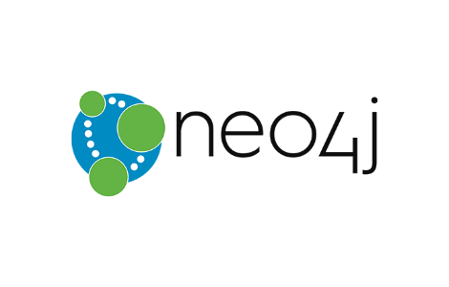

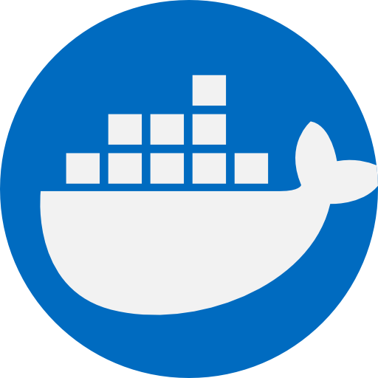
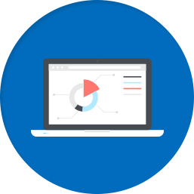
Design Choices and Rationale
Data Storage
Containerization
Relationship Analysis and Storage
API development
Simplicity
Scalability
NoSQL
Complex Relationship Mapping
Searching Engine
Efficiency
Flexibility
Environment Consistency
Enhanced Query Performance
Seamless Integration
Notes:
GuaJi
MongoDB in Docker serves as our primary data storage solution. MongoDB is selected for its exceptional ability to manage large volumes of unstructured data, such as news articles, which vary widely in format and content. Its flexibility allows us to scale as dataset sizes increase, critical for maintaining performance under varying loads. Using Docker, we ensure MongoDB runs in a consistent environment across all deployment stages, from development to production, reducing system discrepancies and improving deployment reliability.
Neo4j is our choice for its robust relationship analysis capabilities. It allows us to map and quickly retrieve complex relational data among entities like tickers which is the company stock name and market trends, providing deep insights into interconnected market dynamics.
Flask is used for its simplicity and efficiency in developing RESTful APIs. It integrates seamlessly with both MongoDB and Neo4j, enabling efficient data retrieval and manipulation, which is vital for providing timely and accurate market analyses to our users.

Slide 7
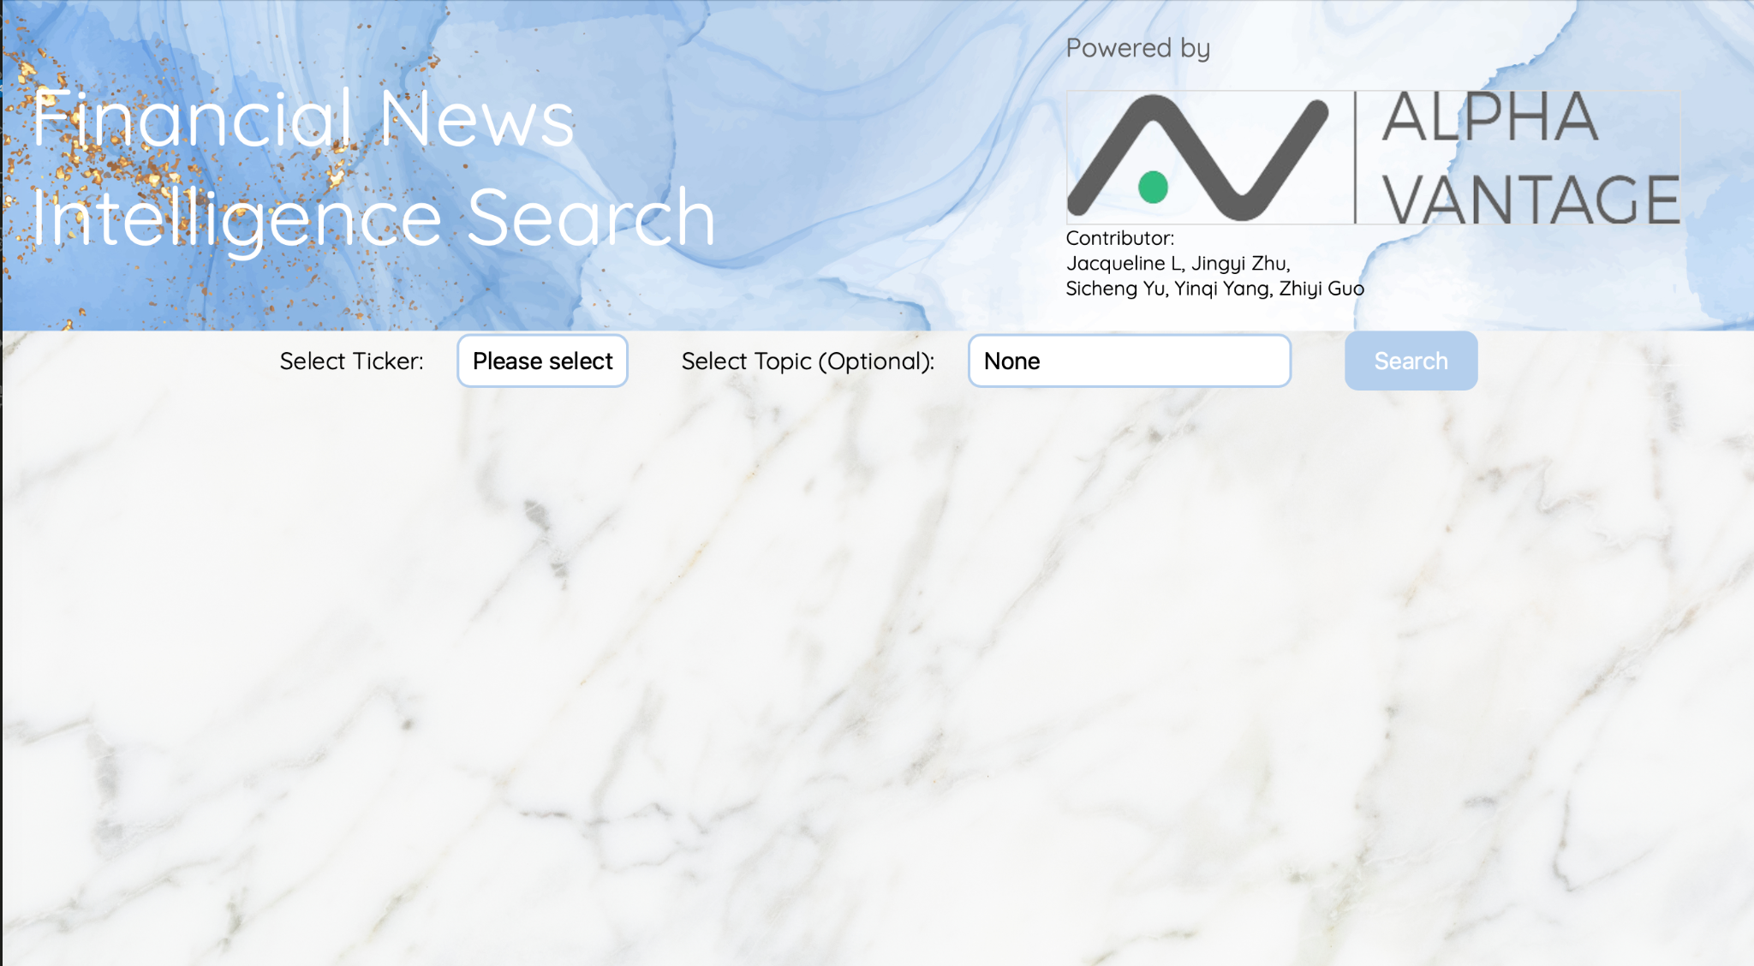
Demo

Slide 8

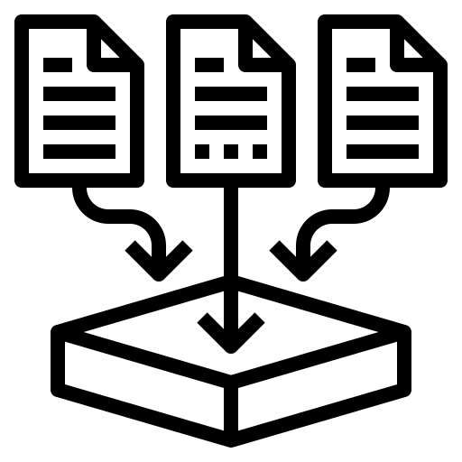
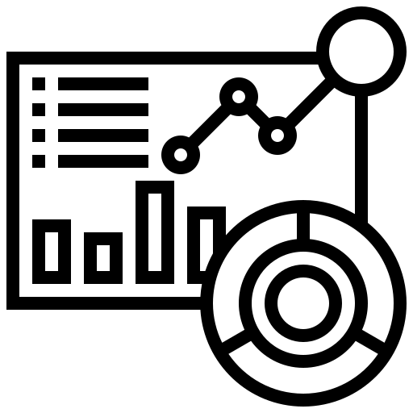
Data Storage, Management, and Governance
Creating a data governance framework and assigning responsibilities are crucial to ensure the proper implementation and enforcement
Access Control
Performance Monitoring
Scalability
Leverage cloud-based storage services
Enforce fine-grained access control policies to restrict access to sensitive data based on user roles, permissions, and authentication mechanisms
Monitoring tools and metrics to track the performance of our data storage and management infrastructure
Notes:
sally
Scalability: We will leverage cloud-based storage services such as Amazon S3, Google Cloud Storage, or Azure Blob Storage for inherent scalability to accommodate the growing volume of market news and sentiment data efficiently
Access Control: We will enforce fine-grained access control policies to restrict access to sensitive data based on user roles, permissions, and authentication mechanisms by implementing identity and access management (IAM) solutions provided by cloud providers
Performance Monitoring: We will deploy monitoring tools and metrics to track the performance of our data storage and management infrastructure to ensure data to be accurate, complete, and consistent

Slide 9

Preliminary Cost Analysis
Data Volume and Variety
Data Volume
1.28GB
(Top 50 companies from S&P 500 with descending order in market cap)
Data Variety
Text-based articles including ‘Title’, ‘Summary’, ‘ Time published’, ‘Authors’, ‘Source’, ‘Source domain’, ‘Category within source’
Images include ‘Banner image URL’
Cloud-Based Data Storage Costs
(Google Cloud Platform)
Storage Costs
$0.026 per month ($0.02/GB per month)
Node Costs
$16.42 per month ($0.0475/hour for 1 vCPU, 3.75 GB memory)
Network Egress Costs
$0.034 per month ($0.12/GB - first GB is free)
Total Estimated Monthly Cost:
$16.48
Notes:
sally
(2) Time
Occur during the initial planning stages of the project and continue throughout the project lifecycle, including design and architecture phase, development and implementation phase, testing and deployment phase, operational phase
(4) Cost Optimization Strategies
Data Lifecycle Management
Establish data retention policies to identify and delete obsolete or redundant data regularly
Regular Review
Conduct regular reviews and audits of cloud resources, configurations, and usage patterns to identify inefficiencies and opportunities for optimization

Slide 10

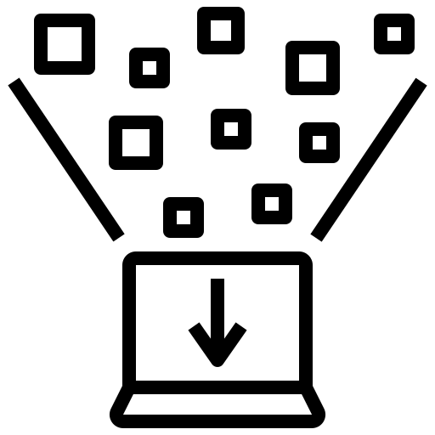




Conclusion and Recommendations
Expand the dataset and broaden the range of companies and topics for application
Enhance techniques for structuring and presenting data to improve effectiveness
Enhance web page visualization to include additional functions and details

Slide 11
Planned Team Contribution
Data store and ETL process designs, as well as the Python implementation of the end-to-end data management application: 20% each
Jacqueline Lin | Implemented design choices and the rationale for using the selected technologies
Jingyi Zhu | Applicable data quality dimensions, licensing, scalability, and any cost implications
Sicheng Yu | Data source specification and procurement details
Yinqi Yang | Background and definition of the data analytics problem
Zhiyi Guo | Implemented design choices and the rationale for using the selected technologies

